Slide 1

Cambodia Early Warning and
Response Network (CamEwarn)
IENG Vanra
World Health Organization

Slide 2
Outline
Surveillance system in Cambodia
Data Flow
ICT assessment
ICT tools
  Surveillance software
  Data reporting
Outcomes
Challenges
Recommendations

Slide 3
Surveillance System
Case-based surveillance (CBS)
  Weekly data transferred to national level every wednesday
  Number of new cases and deaths of the 10 conditions (next slide)
  Influenza Like illness (ILI) sentinel surveillance
  (Epidemiology and Laboratory data)
Event-based surveillance (EBS)
  3 hotlines (2 mobiles & 1 land line)
  Data gathering : Public, Rumor, partners, private clinic, media…etc

Slide 4
Conditions included in Case-based Surveillance
ACUTE DIARRHOEA
FEVER WITH RASH
ACUTE FLACCID PARALYSIS 
SEVERE RESPIRATORY INFECTION
SUSPECT DENGUE FEVER
MENINGITIS / ENCEPHALITIS
ACUTE JAUNDICE
DIPHTHERIA 
RABIES 
NEONATAL TETANUS – suspected 

Slide 5
Data Flow
Ministry of Health
Dept for Communicable Disease Control (CDC)
Provincial health departments (PHD)
Operational Districts (OD)
Hospitals, health centers and other facilities

Slide 6
ICT assessment (2005)
Power supply : Yes
Mobile & Land line networks coverage : Yes
Computers : Yes
Internet : Yes
Database : MS Access and Excel to store / analyze
Power supply : Yes
Mobile & Land line networks coverage : Yes
Computers: Yes
Internet : Yes (expensive)
Database : MS Excel to store / analyze
Surveillance Reporting
Power supply : Yes (limited)
Mobile & Land line networks coverage : Yes
Computers : Yes (limited)
Internet : No
Database : No (paper based)
Health Centers
Referral Hospitals
Operational District
Provincial Health Department
CDC Department
(MoH)
Power supply : No
Mobile & Land line networks coverage : Yes (limited)
Computers : No
Internet : No
Database : No (paper based)
ICT Skills is limited at each level

Slide 7
ICT Tools
Surveillance Software
Data reporting tools

Slide 8
Surveillance Software
CBS : CamEWARN
- Pilot in 4 provinces in 2005 supported by French Cooperation
- Installed since 2006 at National Level and all Provinces
supported by WHO
- Desktop application with Microsoft Access database
- Used for weekly data collection (10 conditions)
- Easy to use and adapt to other countries
Two kind of report can be made
(long and short report (HTML and Word format))
- Data can be analyzed as table, chart and map
The alert parameter can be configured by the
administrator
- Easy to translate to other language

Slide 9
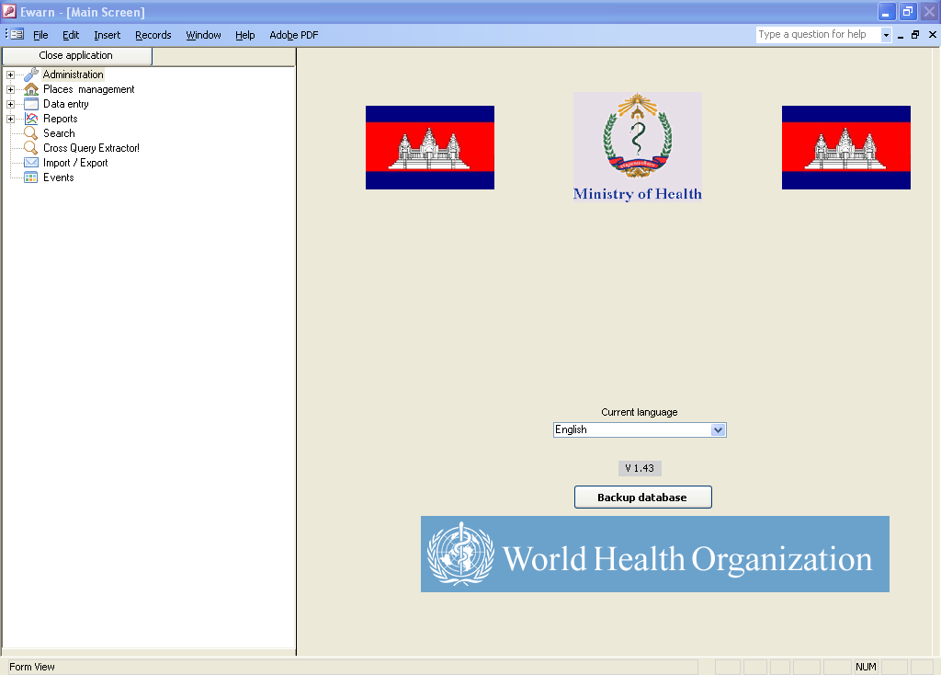
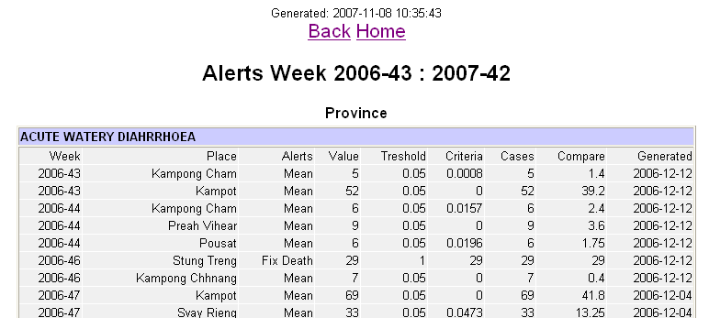
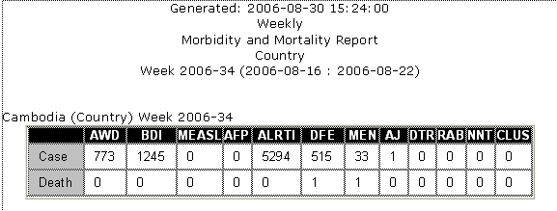
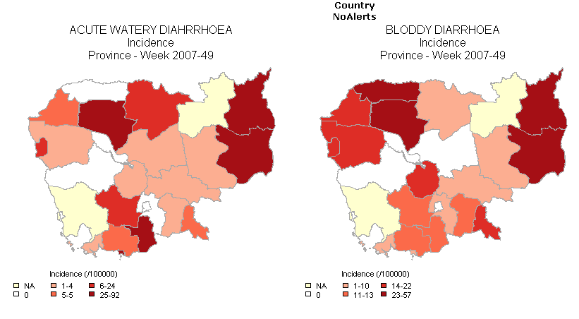
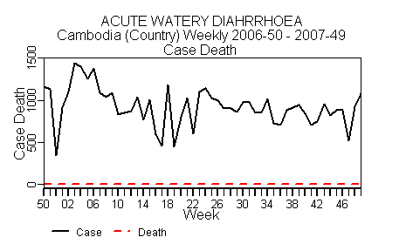
CamEWARN Software

Slide 10


Data Reporting via SMS
National Level
PC connected with phone
Provincial level
PC connected with phone
SMS
SMS
District level
Mobile phone with template SMS
….
….
….
….
….
….
….
….

Slide 11
Data reporting: Remote SMS System
Simple and easy to use
District level : Template SMS + PDA phone
Province : Computer connected with mobile phone(receive / forward the SMS)
National level : Computer connected with mobile phone (receive / feedback SMS to lower level)
System Requirement:
  Cell phone with a service card
  Line Connector to computer – M Bush
  SMS API
  A set of computer which include the SMS API
  Data encode engine
CAMEWARN-SMS
Select Disease
01 - ACUTE DIAHRRHEA
02 - FEVER WITH RASH
03 - ACUTE FLACCID PARALYSIS
04 - SEVERE RESPIRATORY INF.
05 - SUSPECT DENGUE FEVER
06 - MENINGITIS
07 - ACUTE JAUNDICE
08 - DIPHTHERIA
09 - RABIES
10– NEONATAL TETANUS
View
Select
More

Slide 12
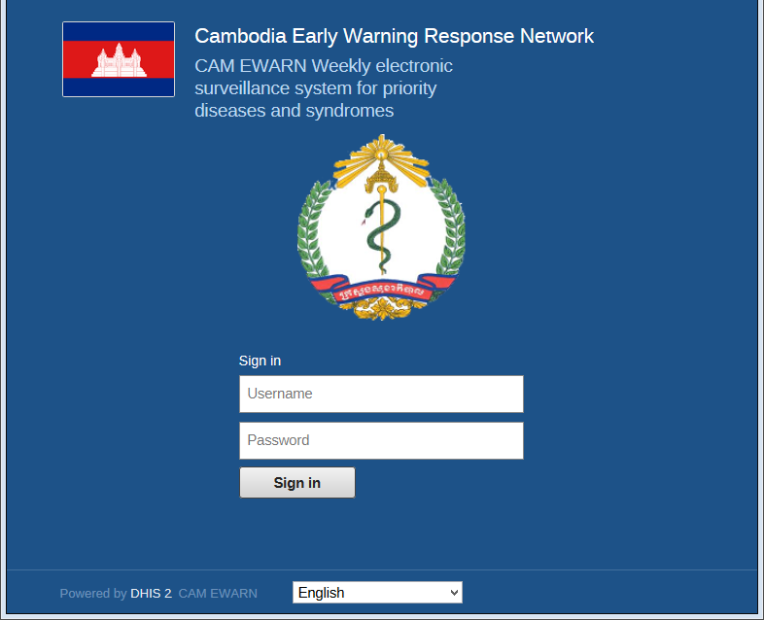
CamEwarn Web based
Started in October 2013, supported by WHO HQ
First pilot in Takeo province and will roll out to countrywide down to district level by the end of 2013.
Implemented based on District Health Information Software 2 (DHIS2)
Free and open-source web-application for collection, validation, analysis, and presentation of aggregated routine data, semi-permanent data (staffing, population estimates) and survey/audit data
flexible user interface and language translation
Data can be entered for later upload when internet connectivity is re-established.
Data security and user control
Notes:
flexible user interface that allows the user to customize the system without the need for programming.

Slide 13
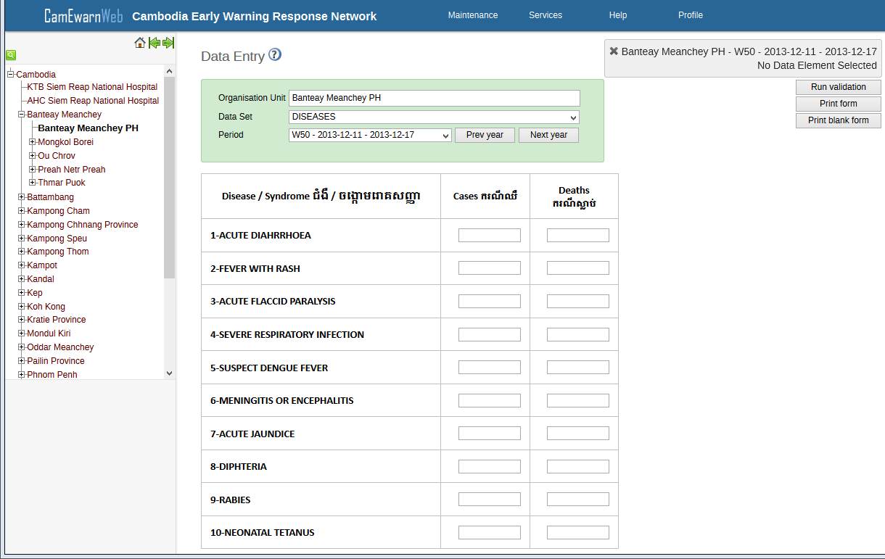
Data Entry
Notes:
flexible user interface that allows the user to customize the system without the need for programming.

Slide 14
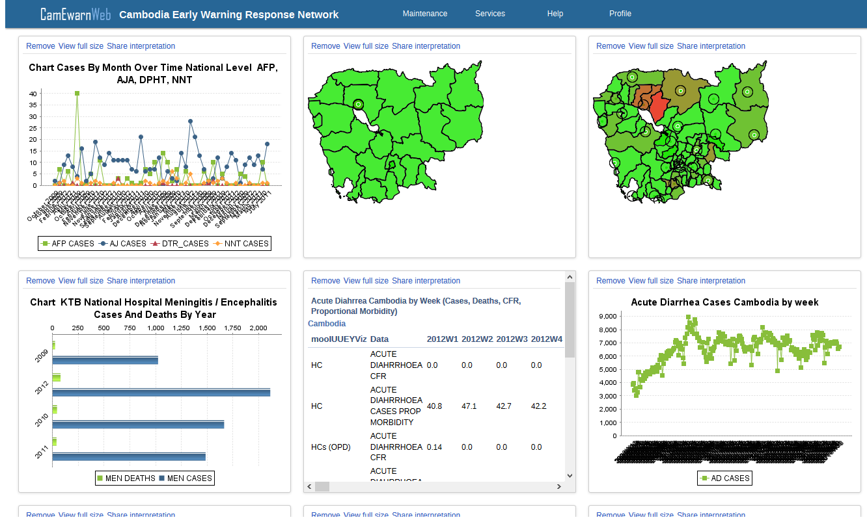
Data visualization
Notes:
flexible user interface that allows the user to customize the system without the need for programming.

Slide 15
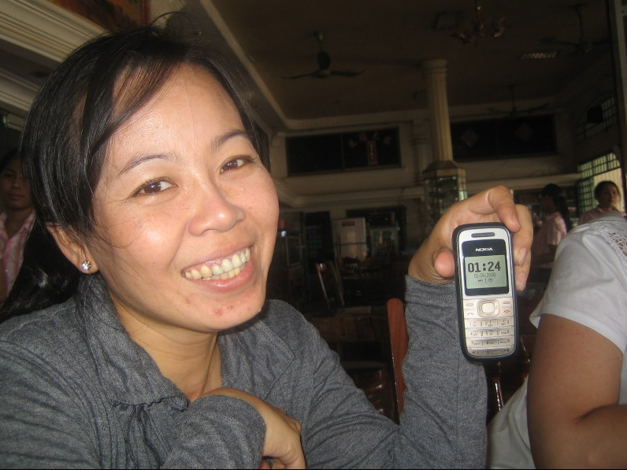
Surveillance Software (cont.)
EBS : Event Base Surveillance
- Installed since 2009 at National Level
- Desktop application with Microsoft Access database
- Used for daily data collection from hot lines
- Reports can be generated weekly, monthly,…etc

Slide 16
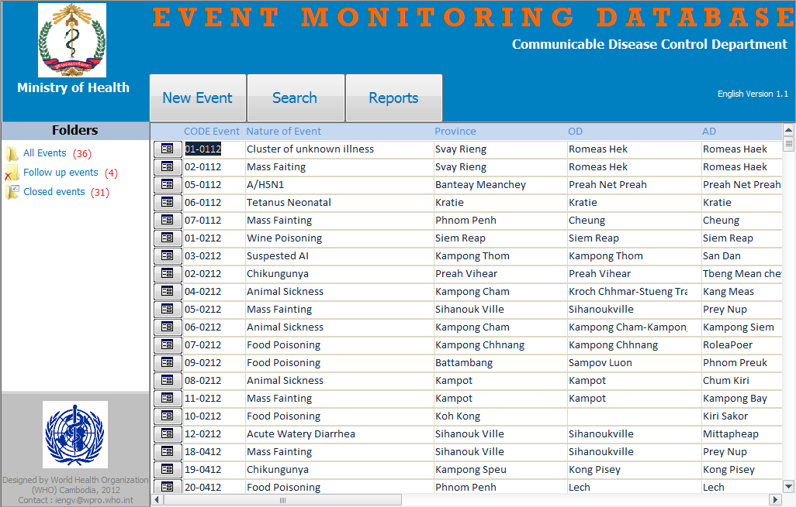
EBS Screenshots

Slide 17
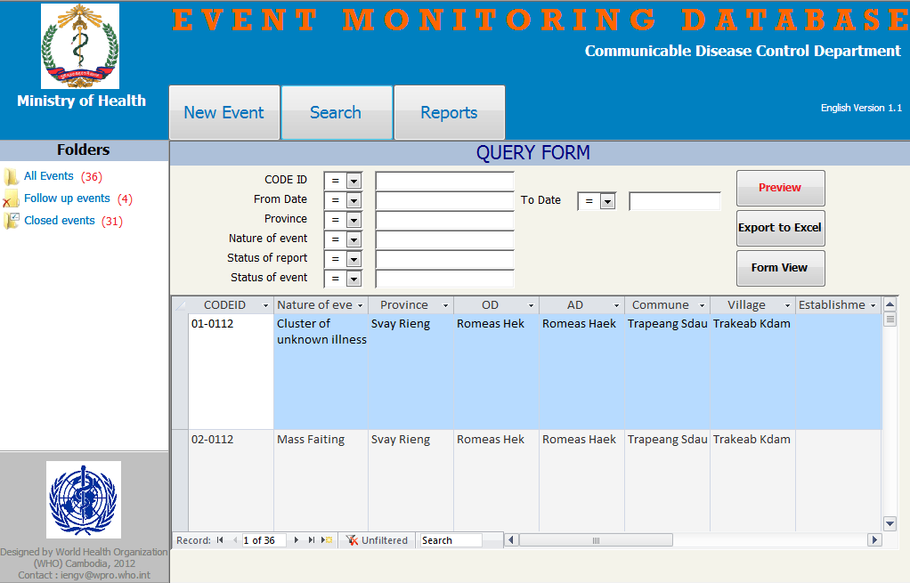

Slide 18
Outcomes
  Timeliness
    Faster data collection and more timely from lowest level up to national level
    Faster response and provide feedback
  Completeness
    More data is capturing at each level
    Improvement the relationship among health staff
  Data Analysis
    Faster data analysis
    Reports can be generated in various ways

Slide 19

Challenges
  Hardware & Software failure : PCs & Phone
  Human resources with ICT capacity
  Data quality
  Behavior change
  Risk assessment

Slide 20
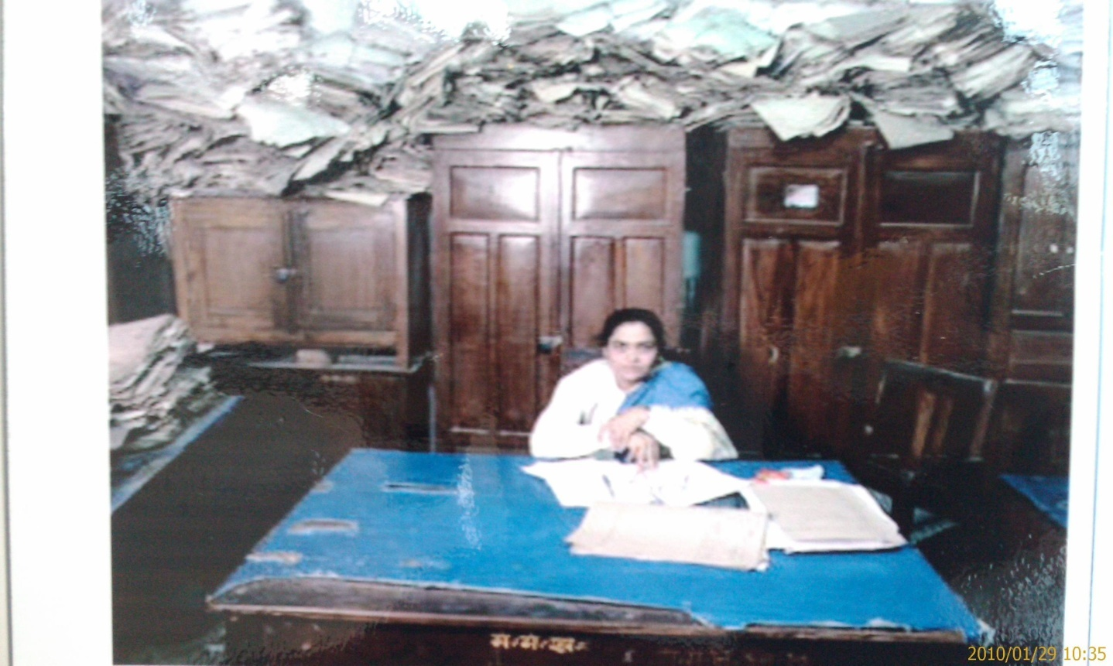
THANK YOU
Notes:
20

